Slide 1
Nutri - Emma
IBM AICTE PROJECT
Presented By: Suhani Avasthy
College Name & Department : GB Pant DSEU – B.Tech CSE

Slide 2
OUTLINE
Problem Statement
Technology used
Wow factor
End users
Result
Conclusion
Git-hub Link
Future scope
IBM Certifications

Slide 3
Problem Statement
The Challenge - In an era where health awareness is growing, individuals increasingly seek personalized nutrition guidance. However, most existing tools provide generic diet plans, lack real-time adaptability, and fail to consider a person's holistic lifestyle, cultural preferences, allergies, and evolving health conditions. Furthermore, dieticians and nutritionists face limitations in scaling personalized consultations due to time and resource constraints.
Generative AI presents a groundbreaking opportunity to revolutionize this space by enabling an intelligent, interactive, and adaptive virtual nutrition assistant. By leveraging natural language processing (NLP), multimodal understanding, and large-scale dietary databases, an AI-powered assistant can generate dynamic meal plans, recommend smart food swaps, and explain nutritional choices—all tailored to the individual.
Proposed Solution: An AI Research Agent that uses Natural Language Processing (NLP), and Web Scraping to give up a tailored Diet Plan as well as a customized Workout Plan to help you achieve your goals in time and with efficiency.

Slide 4
Technology used
IBM cloud lite services
Natural Language Processing (NLP)
IBM Granite model

Slide 5
IBM cloud services used
IBM Cloud Watsonx AI Studio
IBM Cloud Watsonx AI runtime
IBM Cloud Agent Lab
IBM Granite foundation model

Slide 6
Wow factors
Generate personalized meal plans based on health goals, medical conditions, fitness routines, and preferences
Offer contextual explanations (e.g., “Why is this food better?”)
Adapt suggestions dynamically with continuous feedback
By integrating health data, food databases, and LLM-powered reasoning, the solution bridges the gap between one-size-fits-all diet apps and in-person nutrition counselling—delivering an AI that thinks, learns, and cares like a real nutrition expert.

Slide 7
End users
People who want to curate their lifestyle
Healthcare professionals
Students who don’t have access to a nutrition expert
Athelets

Slide 8
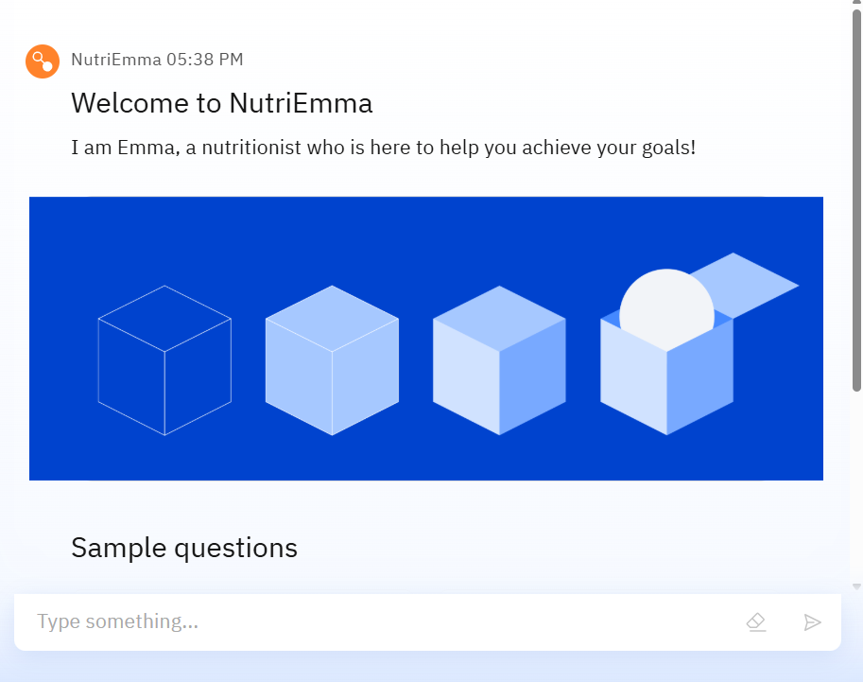
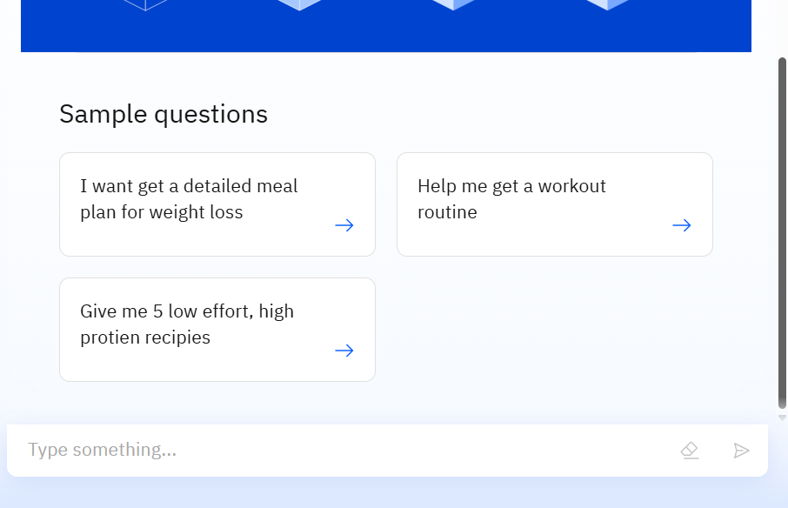
Results (Agent Preview)

Slide 9
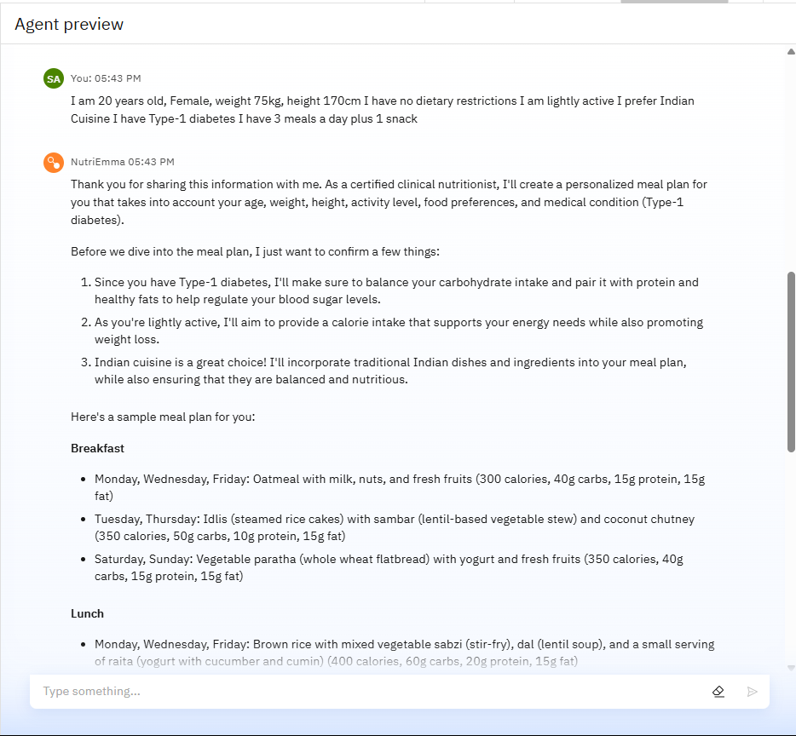
Results

Slide 10
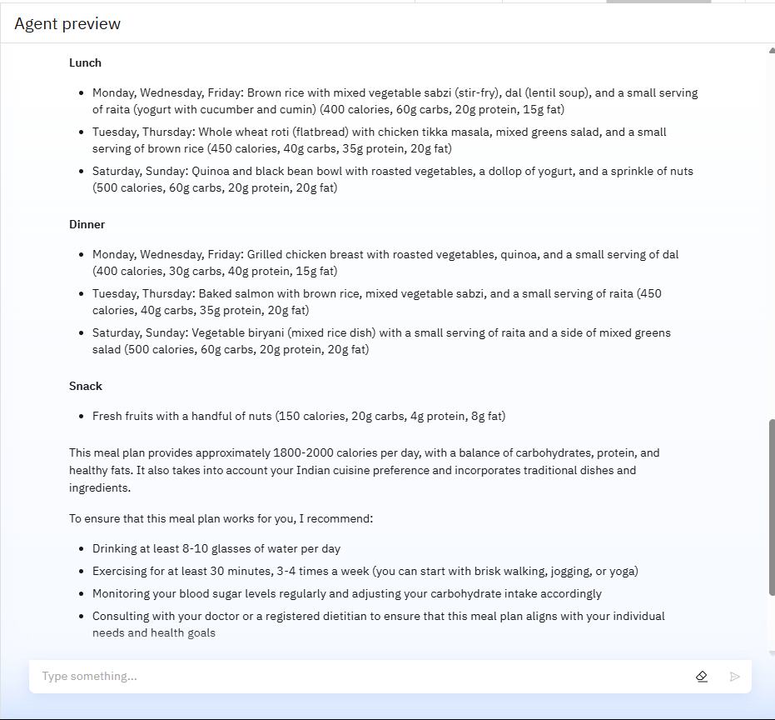
Results

Slide 11
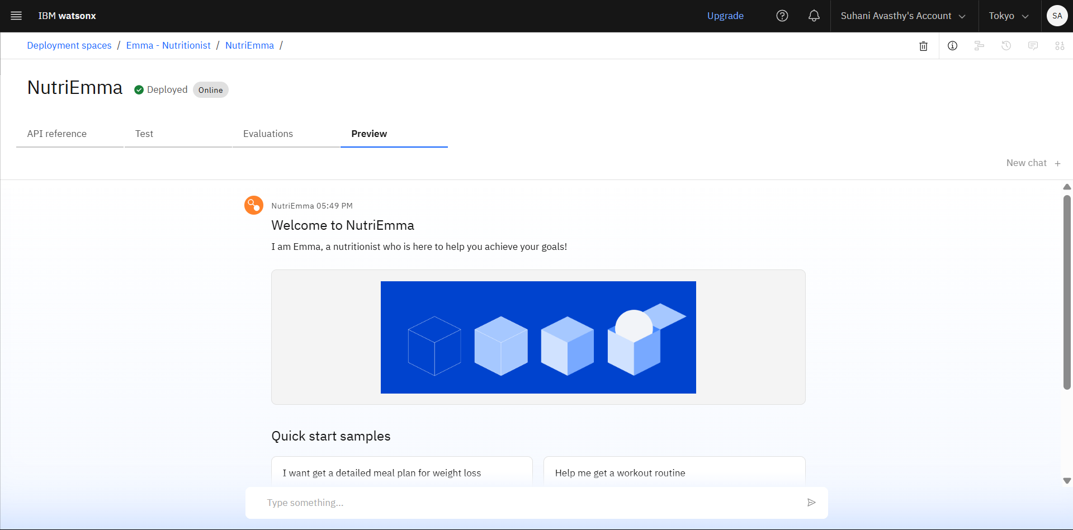
Results
Deployed AI Agent

Slide 12
Conclusion
The agent can generate Diet Plan for the whole week
It saves time by reducing the time taken in thinking and coming up with nutritional and tasty recieps.
It also suggests workout plans and learns based on your preference and edits the plans accordingly
Can alter and customise nutrition based on medical conditions and requirements.

Slide 13
GitHub Link
Make sure that there should be readme file - https://github.com/suhaniavasthy/Nutri-Emma-Nutrition-Agent-

Slide 14
Future scope
Multilingual Support
Voice-Activated Nutrition Assistant
Image based input to suggest balanced meals based on the ingredients you have
Integration with fitness bands and devices

Slide 15
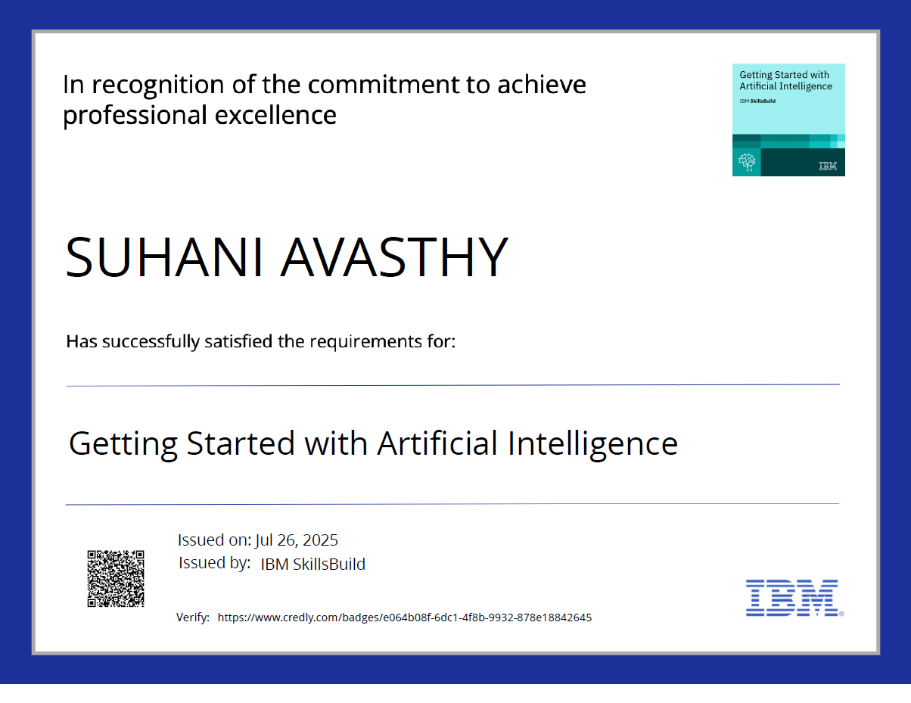
IBM Certifications

Slide 16
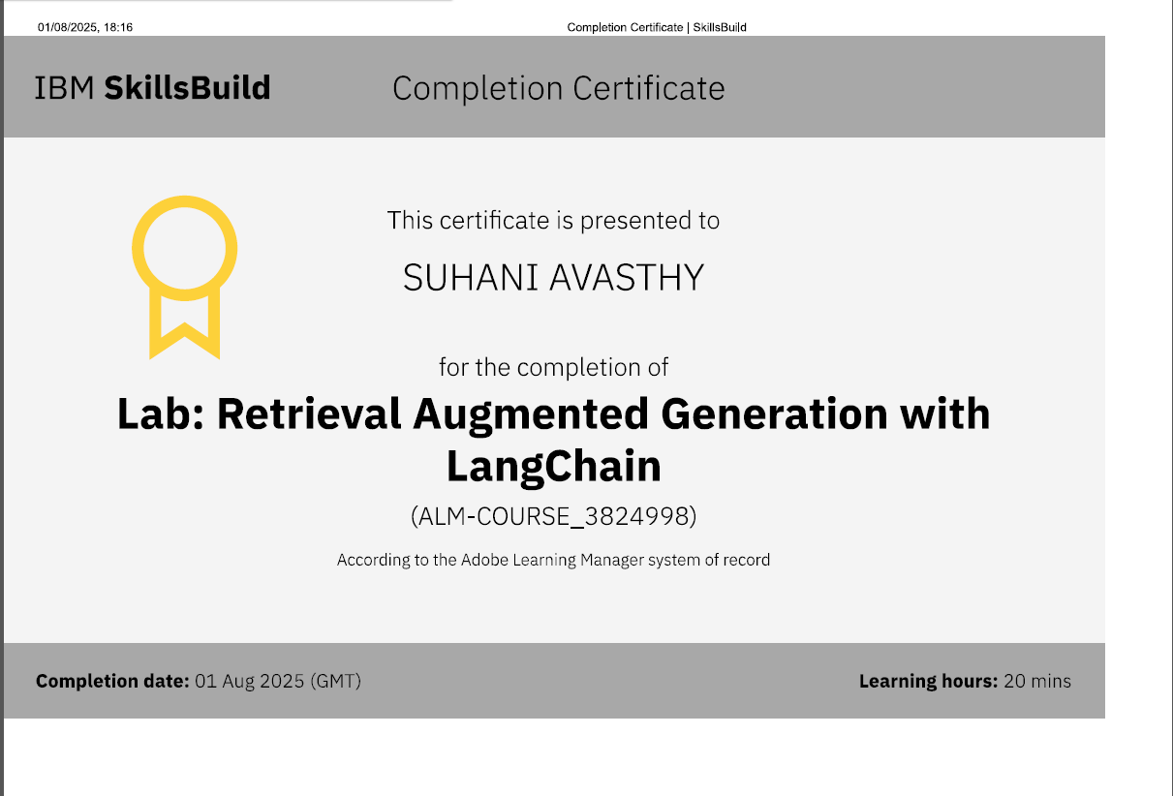
RAG LAB certificate

Slide 17
THANK YOU

